Slide 1
Dungeon of the Mighty Titan - Vanquish
Demo & User Training
David Bond, Matthew Yengle, Timothy Canipe, Vishal Bhatt

Slide 2
Requirements Status
(COMPLETED) A turn-based movement and combat system.
(COMPLETED) Feature an attribute system.
(COMPLETED) Be represented using a visual method of design (GUI) that the player will be able to view and interact with.
(COMPLETED) Be able to run on desktop computers running Windows 7 or newer.
(COMPLETED) Use Unreal Engine’s C++ API and scripting language Blueprint
(COMPLETED) Development environment will be Unreal Editor and Microsoft Visual C++
(COMPLETED) Use the Steam SDK package to allow Steam users to join game sessions
(COMPLETED) Have an inventory system with an item database.
(COMPLETED) Allow the player to interact with aspects of the game
(PENDING) Include multiplayer functionality
(PENDING) A combat system that gives the player options depending on their class
(PENDING) Give playable character classes unique skills that distinguish them from other character classes.
(NO PROGRESS) Save the state of the game.
(NO PROGRESS) Allow a user to load the saved game.

Slide 3
User Training
README file
Instructional Screenshots
Play the Game

Slide 4
Instructional Screenshots

Slide 5
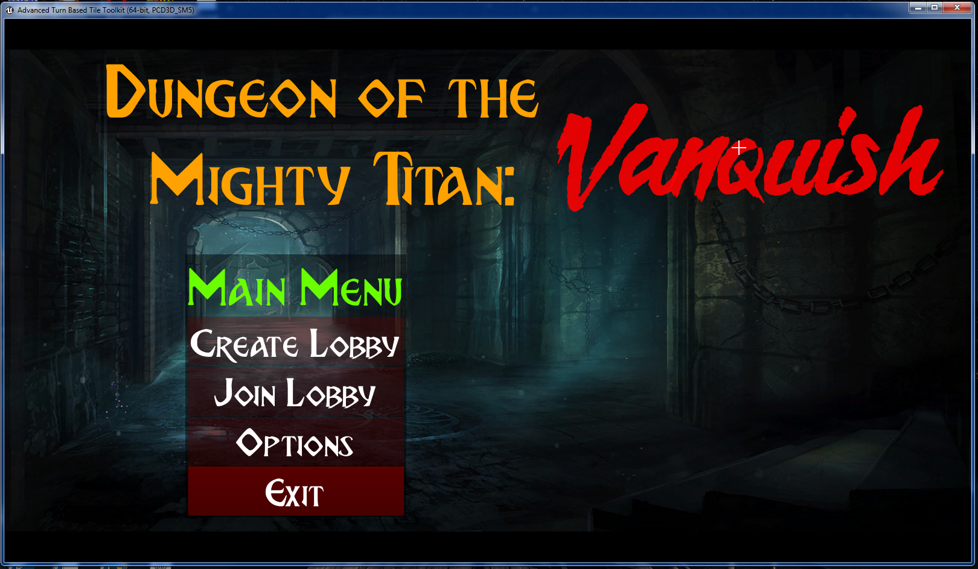
User Training
Main Menu
Serves as the default landing screen. Game options can be set, and the player can host or join a game; or, exit.
Click to host a match
Click to search for a match
Click for Game Options
Click to Exit the Game

Slide 6
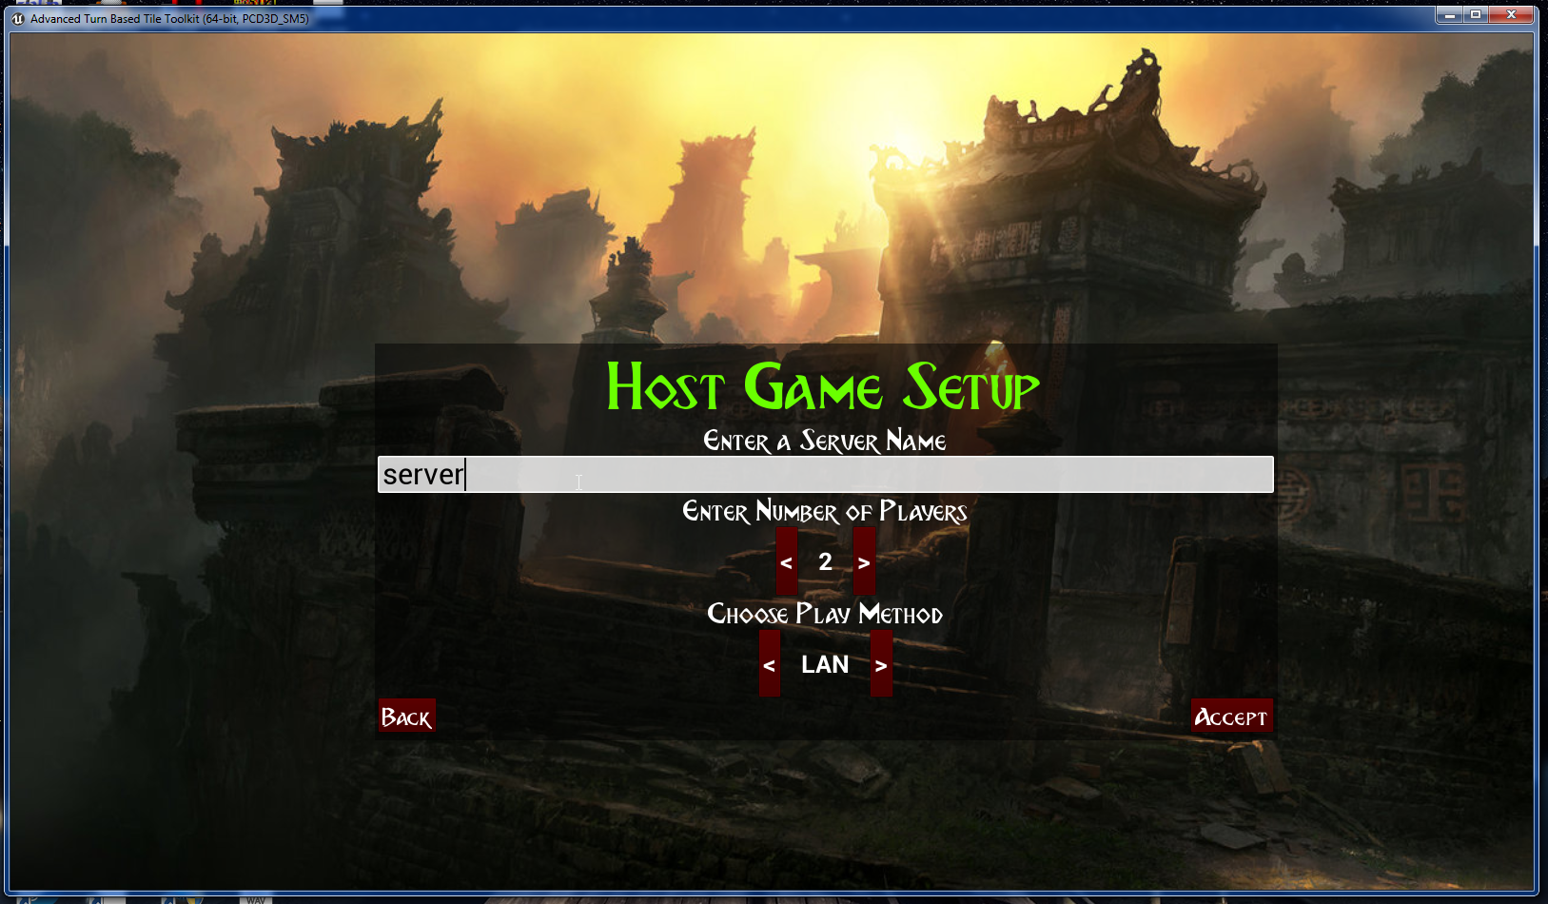
Host a Match
Host Match
This screen appears when you press the ‘Create Lobby’ button. This menu allows a host to set a server name, the number of players, and whether to connect over a LAN or Internet (using Steam).
Note: The server must have a name, or you will not be able to start the match (‘Accept’ button will stay gray).
Enter a server name.
3. Toggle playing over LAN or Internet (Steam)
2. Adjust number of players
Back to Main Menu
4. Start Session

Slide 7
Demo

